Slide 1
Project on Pharmaceutical Sales Prediction
Leveraging Machine Learning to Accurately Forecast Sales Across Multiple Stores

Slide 2
Introduction
Rossmann Pharmaceuticals has commissioned a project to develop a sales forecasting system. The finance team needs a tool that can accurately predict sales for all their stores across different cities, six weeks ahead. At present, store managers rely on their experience and judgment to forecast sales. However, the data team has pinpointed several key factors that significantly affect sales, including promotions, competition, school and state holidays, seasonality, and geographic location.
The aim is to create a complete end-to-end solution that delivers precise sales forecasts to the finance team, enabling them to make informed, data-driven decisions.

Slide 3
Objective
The primary goal of this project is to create a dependable predictive model that forecasts future pharmaceutical sales across various store locations. This model will enable store managers to make data-driven decisions regarding inventory management and staffing, ultimately enhancing operational efficiency and customer satisfaction. Additionally, the model will empower the finance team with precise sales predictions, allowing them to refine sales strategies and improve overall business performance.

Slide 4
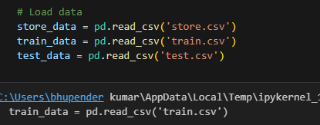
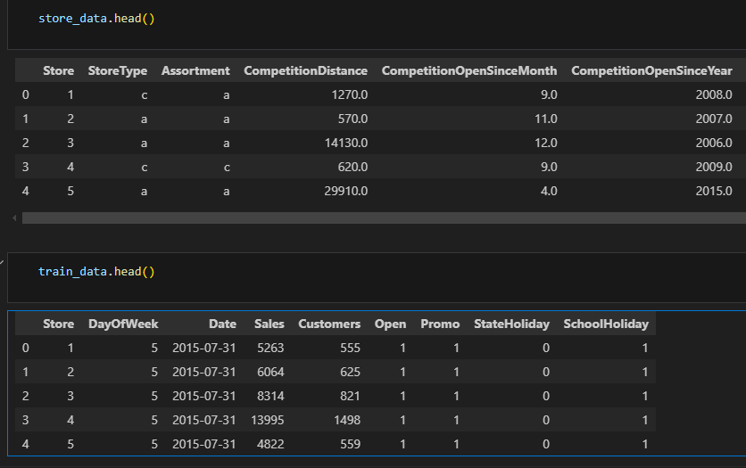
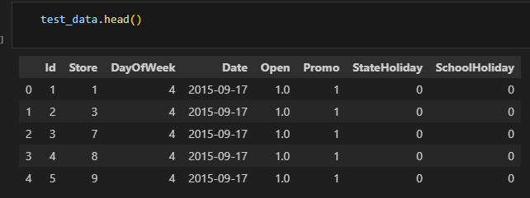
Load and show the data

Slide 5
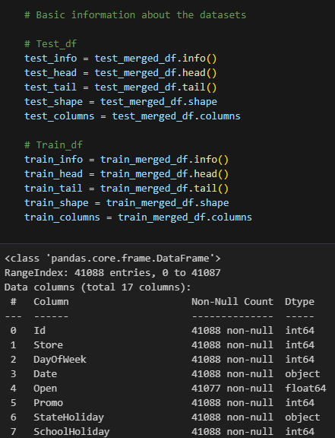
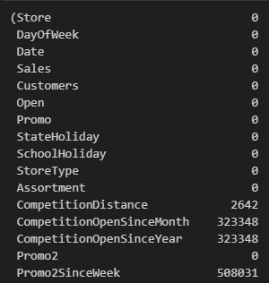
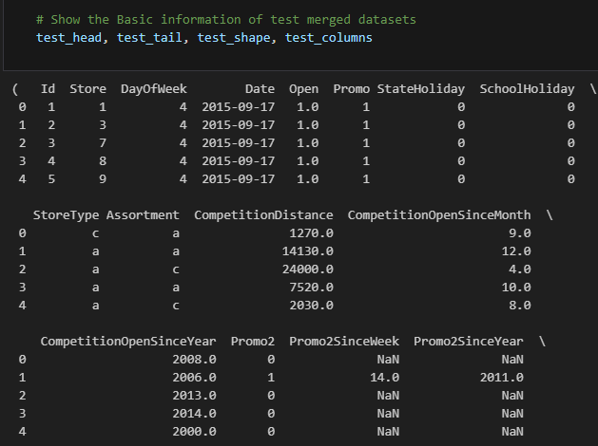
Merge and show the data set
Check the missing value

Slide 6
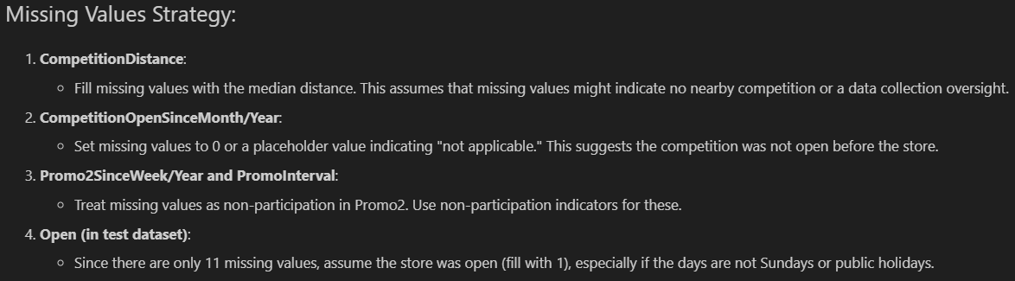
Missing values starategy

Slide 7
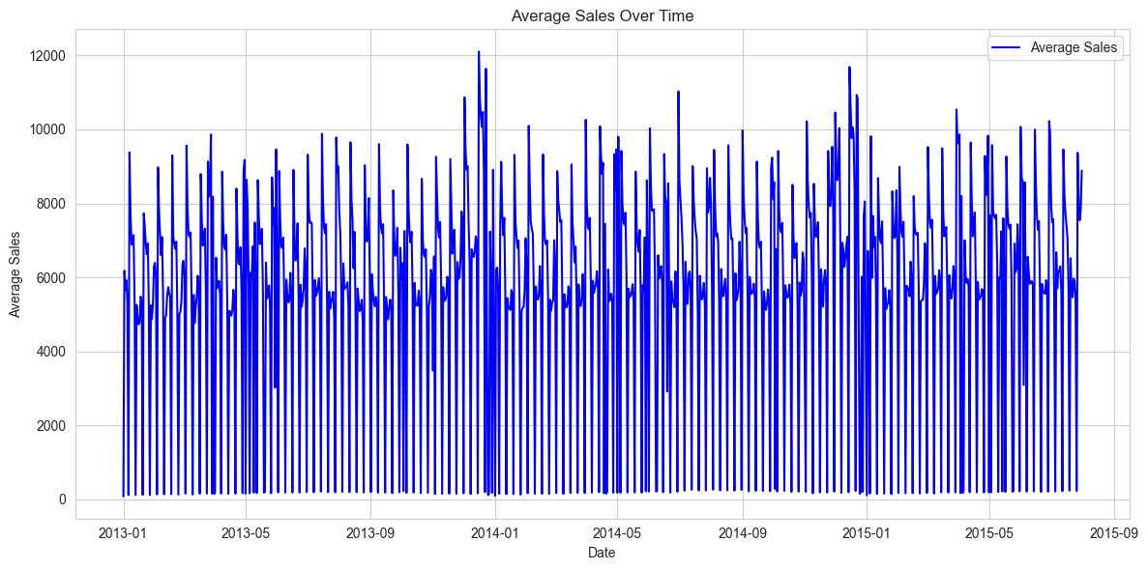
Eda

Slide 8
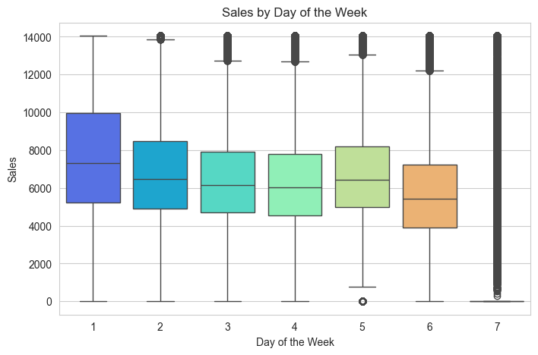
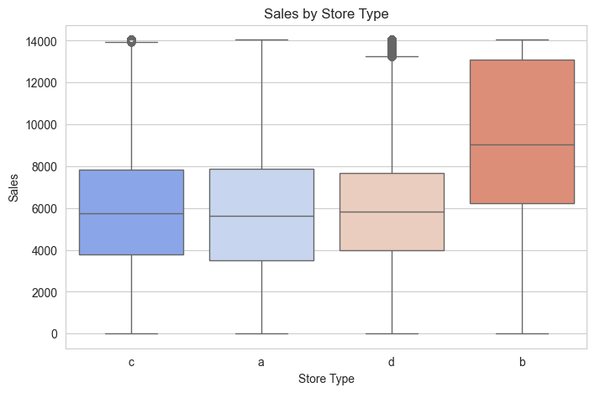
Sales by day of the week
Examine how sales differ across different store types

Slide 9
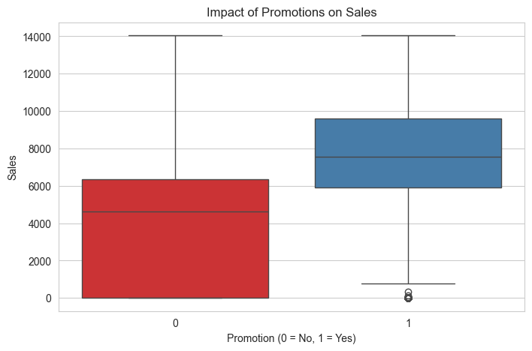
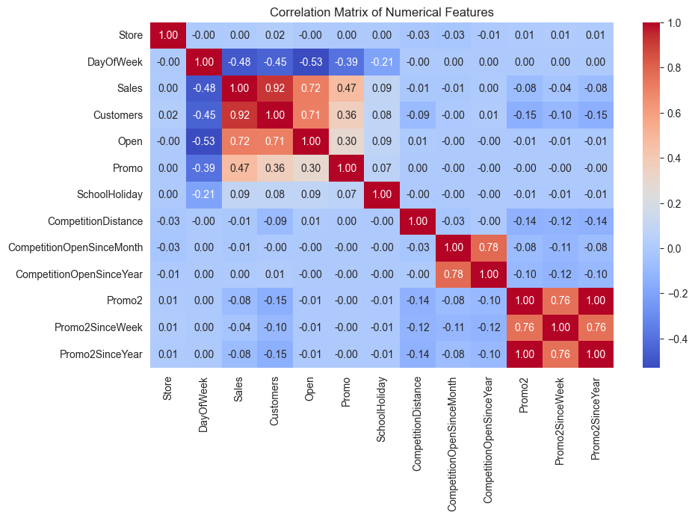
Investigate the effect of promotions on sales
Correlation Analysis relationships between numerical features

Slide 10
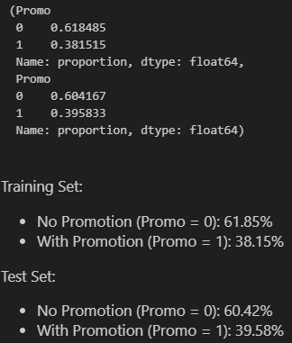
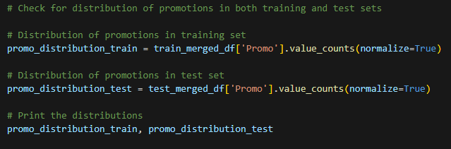
Task 1 - Exploration of customer purchasing behaviour
The promotion distributions in the training and test sets are quite similar, showing a consistent approach to promotions in both sets.

Slide 11
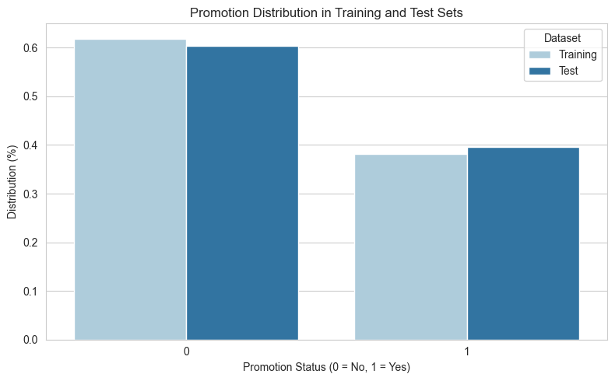
Distribution of promotions in training and test sets for visualization
The bar chart shows how promotion days (Promo) are distributed in both the training and test sets. Here are the main points:
A
- **Promotion Distribution:** Both datasets have similar promotion and non-promotion days. In the training set, about 38% of the days have promotions (Promo = 1), and 62% do not (Promo = 0). The test set has about 40% promotion days and 60% non-promotion days.
- **Comparison:** The similar distribution of promotions in both sets suggests the test set is representative of the training set regarding promotional activities.

Slide 12
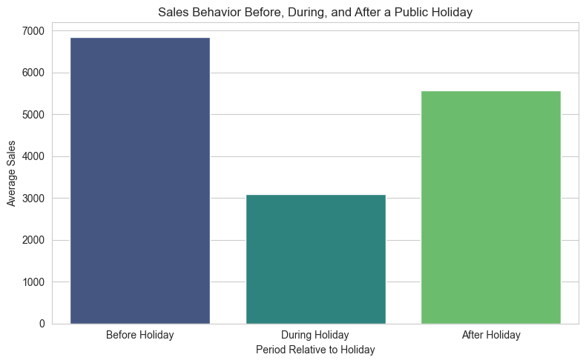
Create a Data Frame to visualize sales before, during, and after the holiday
The bar chart shows how sales behave before, during, and after a public holiday:
- **Before the Holiday:** Sales are highest during this time. This might be because customers are shopping in preparation for the holiday.
- **During the Holiday:** There’s a big drop in sales. This could be due to store closures or shorter hours, as well as fewer people shopping because they’re focused on holiday activities.
- **After the Holiday:** Sales begin to recover but are still lower than before the holiday. This likely shows a gradual return to normal shopping patterns after the holiday.

Slide 13
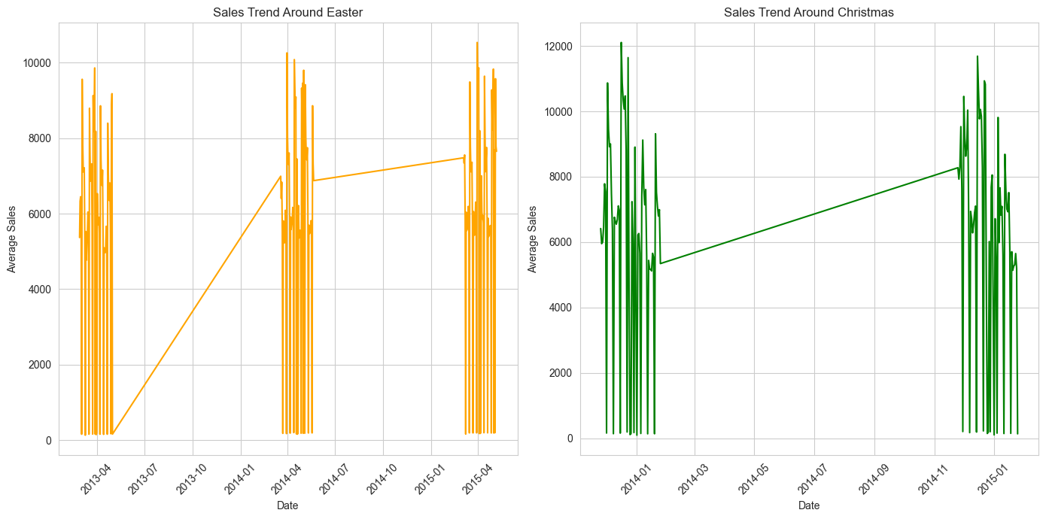
Analyse seasonal purchase behaviours around Christmas and Easter
The line charts show sales trends around Easter and Christmas, highlighting seasonal shopping behaviors:
### Easter Sales Trend
- **Before Easter:** Sales increase as the holiday approaches, likely because people are buying items for Easter celebrations.
- **During Easter:** There’s usually a dip in sales on Easter itself, possibly due to store closures or less shopping as people focus on holiday activities.
- **After Easter:** Sales gradually return to normal, indicating the end of the holiday shopping period.
### Christmas Sales Trend
- **Before Christmas:** Sales rise significantly leading up to Christmas, as many consumers are buying gifts and preparing for the holiday, resulting in a big sales surge.
- **During Christmas:** A sharp drop in sales occurs around Christmas, consistent with stores being closed or fewer people shopping on that day.
- **After Christmas:** Sales often increase right after Christmas, reflecting post-holiday sales, exchanges, or the use of gift cards received during the holiday.

Slide 14
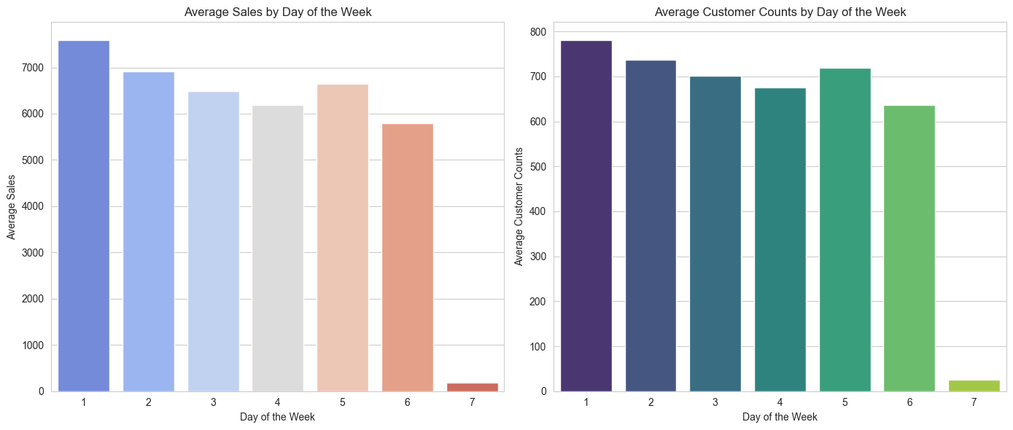
Visualizing the trends in sales and customer counts by day of the week

Slide 15

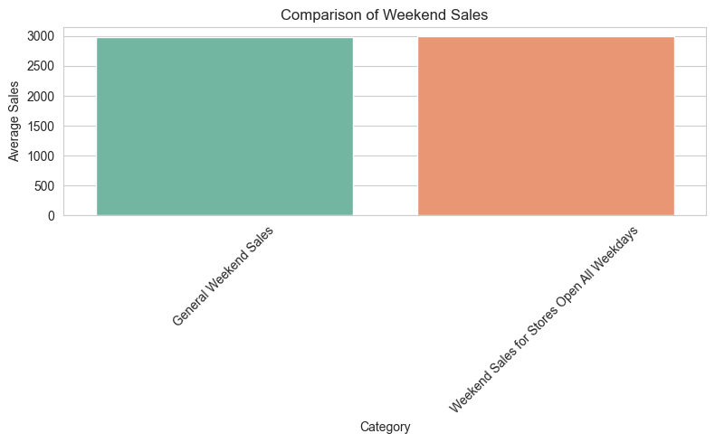
compare the general weekend sales average

Slide 16
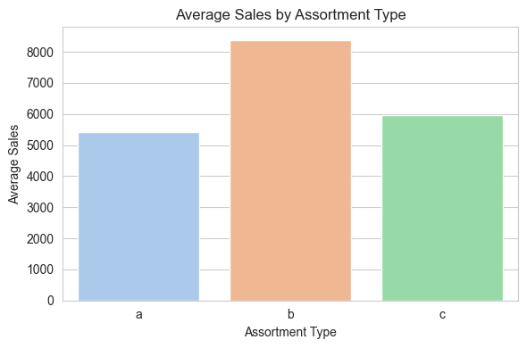
Aggregate sales by assortment type

Slide 17
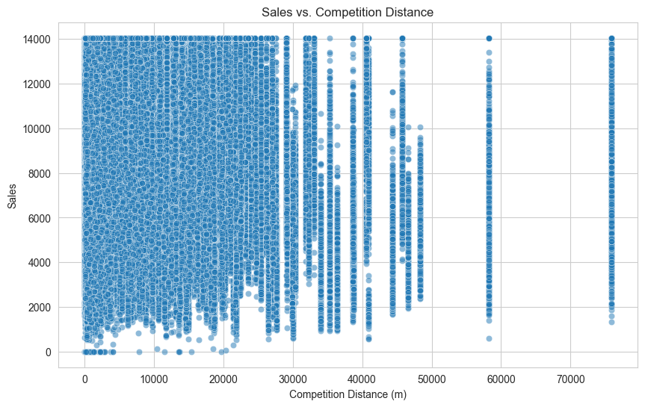
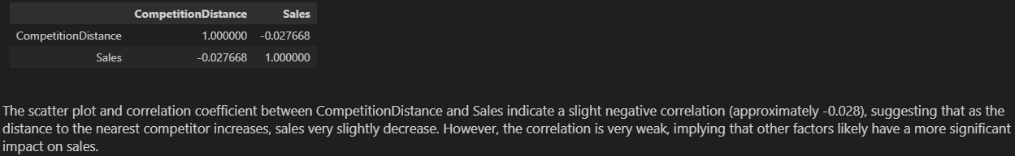
Scatter plot to analyze the relationship between competition distance and sales

Slide 18
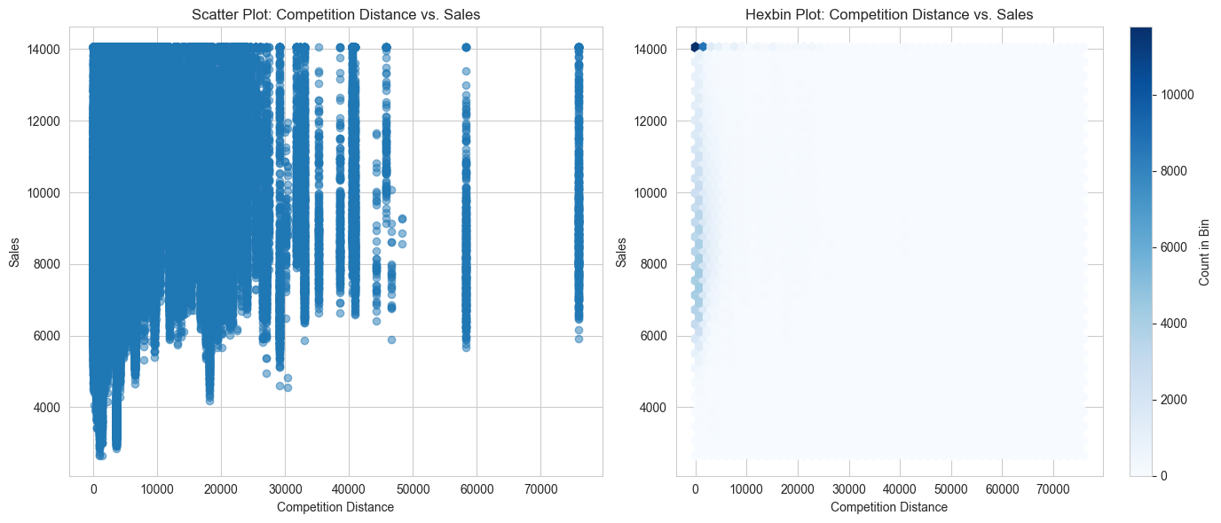
Visualizing the relationship between competition distance and sales for high customer density stores

Slide 19
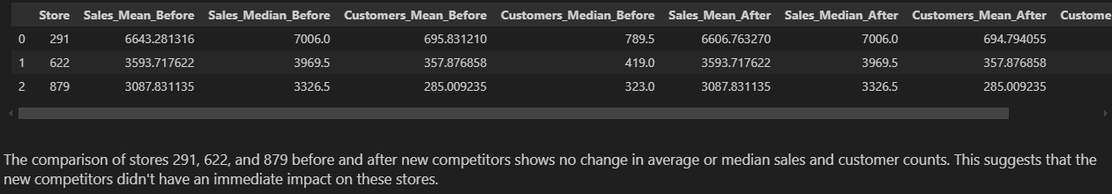
Filter data for the identified stores before and after update

Slide 20
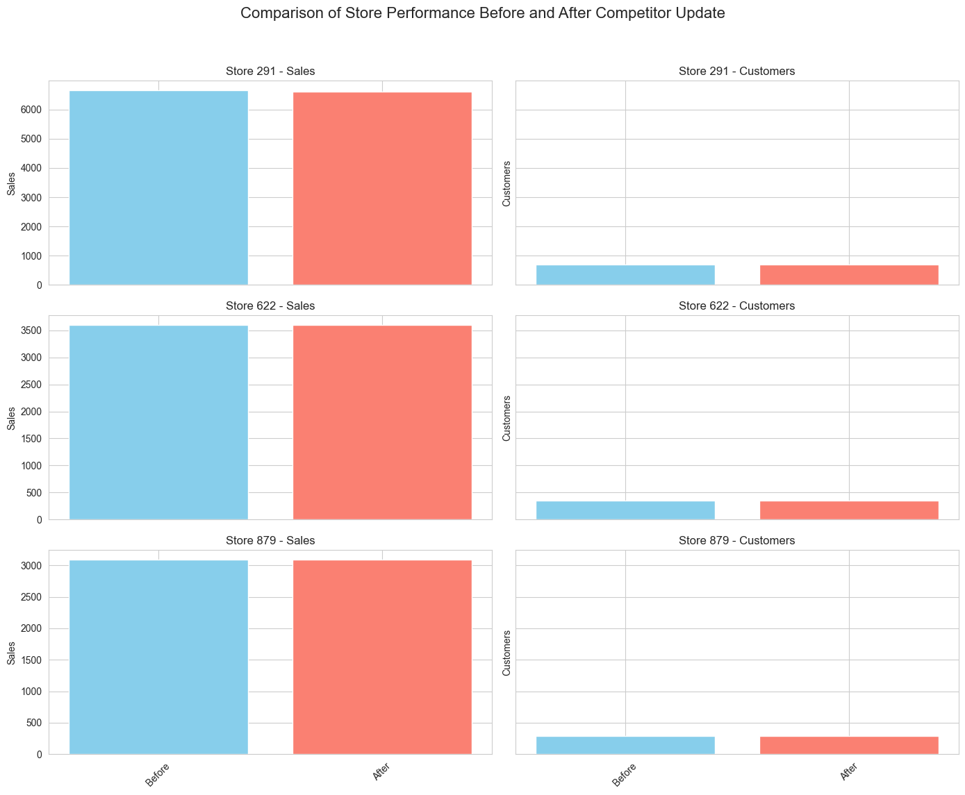
Filter data for the identified stores before and after update

Slide 21
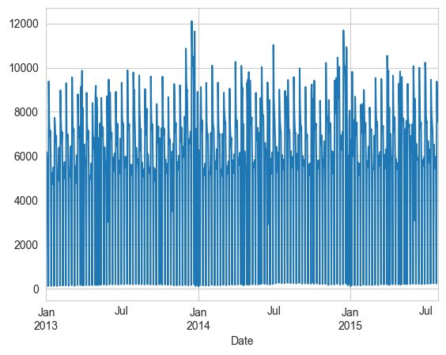
Task 1.2 - Logging
Log your steps using the logger library in python.
Visualization, e.g., plotting sales trends

Slide 22
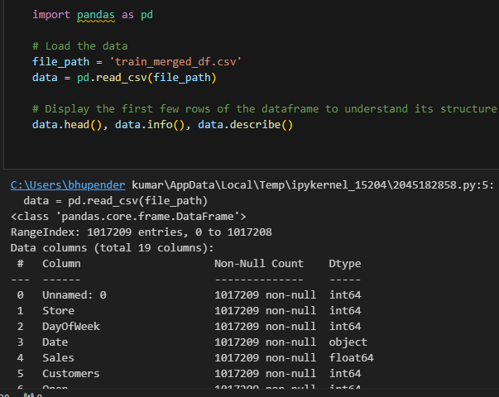
Task 2 - Prediction of store sales
Prediction of sales is the central task in this challenge. We will predict daily sales in various stores up to 6 weeks ahead of time.
Load and show the data

Slide 23
2.1 Pre-processing
We will do the feature engineering as per below:‘Is this locus of enigma and desirable mystery the site and source of pornographic pleasure?’, asked Christopher along with others about/for this putative locus of pornographic pleasure.
- Drop Unnecessary Columns: I suppose that Unnamed: 0 is not very useful in this case as it appears to be a duplicate of the index.
- Date Handling: time = timeconvert(time,media)
time = pd.to_datetime(time) We can also get things like the year, month and day which may be helpful to the model.
- Categorical Variables: Scale the textual values of such nominal variables as StoreType, Assortment, or even PromoInterval if the model and its interpretability will require it.
- PromoInterval Processing: The PromoInterval shows that independent variable needs extensive manipulation to get fitted into a format that is conducive for machine learning model.

Slide 24
initial feature engineering
The PromoInterval column has four unique values: They are ‘0’, ‘Jan, Apr, Jul, Oct’, ‘Feb, May, Aug, Nov’, and ‘Mar, Jun, Sept, Dec’. This suggests a straightforward approach to feature engineering: It results in creating binary features for each of the twelve months to describe whether a promo is active during that particular month given the PromoInterval string.

Slide 25
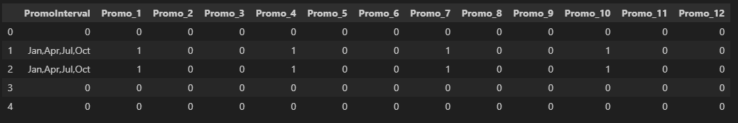
Initialize columns for each month to 0
The transformation of the PromoInterval column into binary features for each month has been successfully completed. For each record, there are now twelve binary features (Promo_1 to Promo_12), indicating the active promo months based on the PromoInterval information.
With these steps, the data now includes:
Year, month, and day extracted from the original Date column.
Encoded categorical variables for StoreType and Assortment.
Twelve binary features representing the active promo months.

Slide 26
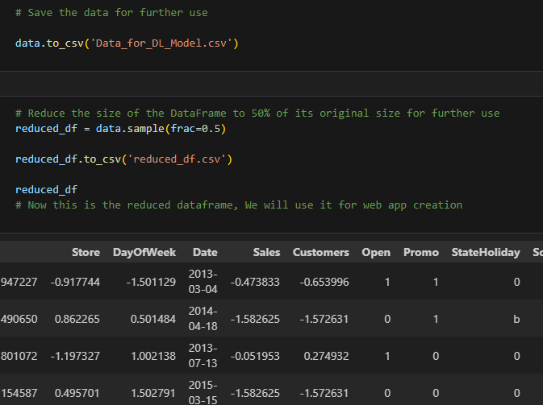
Save and reduce the data

Slide 27

2.2 Building models with sklearn pipelines
The steps for building the model with a pipeline :
1) Define the features (X) and the target (y). For simplicity, we'll use all scaled and encoded features for X and Sales for y.
2) Split the dataset into training and testing sets to evaluate the model's performance.
3) Create a pipeline that includes any necessary preprocessing steps and the Random Forest Regressor.
4) Train the model using the training data.
5) Evaluate the model's performance on the test set.
Splitting the dataset into training and testing sets

Slide 28
Creating the pipeline with a Random Forest Regressor
Our Random Forest Regressor model was trained and evaluated through our scikit-learn pipeline to return an MSE on the test set of approximately 0.0124, with an R-squared proper value of about 0.987.
The R² value tells us that our model could explain about 98.7% of the variance in the sales data, which is pretty high performance in itself for this kind of regression problem. MSE is a measure of the average of the squared differences between the observed actual outcomes and those predicted by the model.
Overall Interpretation: The model is really good; we have a very high R² value, 0.96, with a low MSE, which tells us it does correctly predict sales, and in this case, most of the variance in sales data is captured by our model.

Slide 29
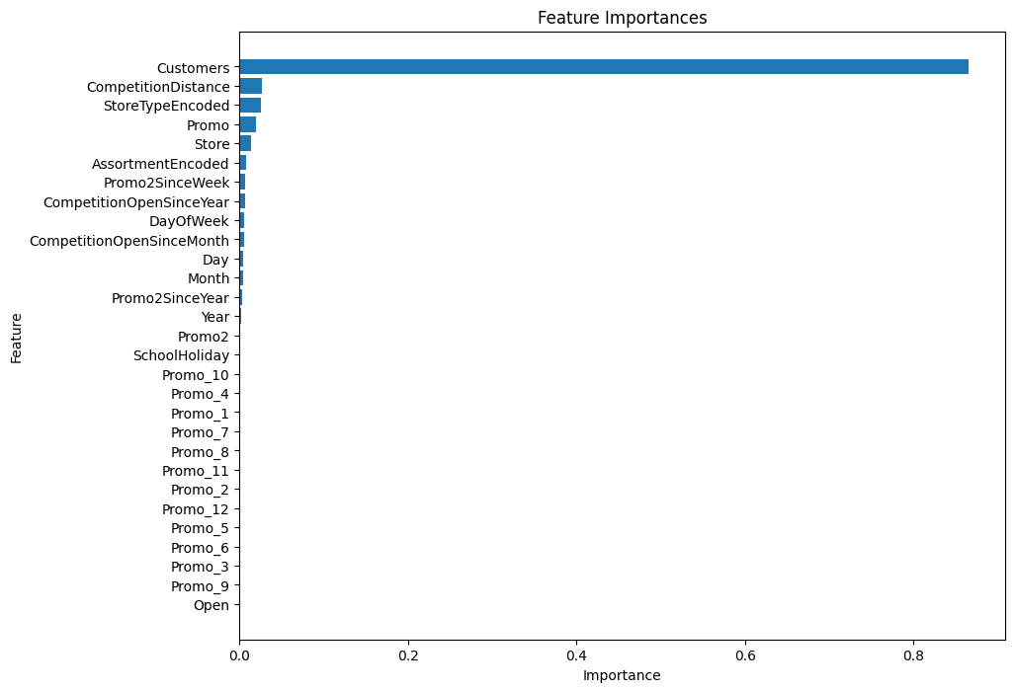
2.4 Post Prediction analysis
Feature Importance Analysis

Slide 30
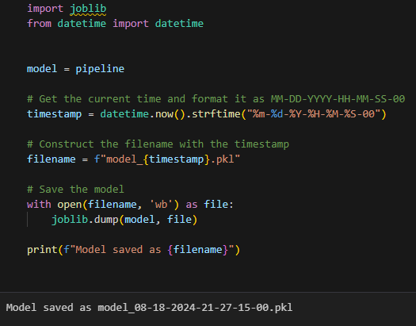
2.5 Serialize models

Slide 31
2.6 Building model with deep learning
We will use Deep Learning, specifically a Long Short Term Memory (LSTM) model, to predict future sales and other outcomes. The steps we'll take include:
1. Convert the Rossmann Store Sales dataset into time series data.
2. Check if the time series data is stationary (i.e., its statistical properties remain constant over time).
3. If the data is not stationary, apply differencing to make it stationary.
4. Analyze the autocorrelation and partial autocorrelation of the data.
5. Transform the time series data into a supervised learning format by creating a target column (y).
6. Scale the data to a range of (-1, 1).
7. Build an LSTM model to predict future sales.

Slide 32
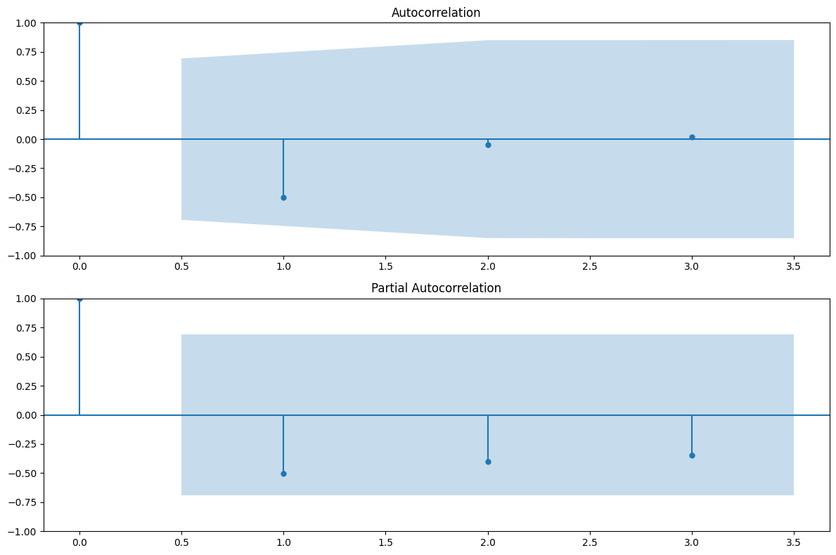
Check for autocorrelation and partial autocorrelation of your data

Slide 33
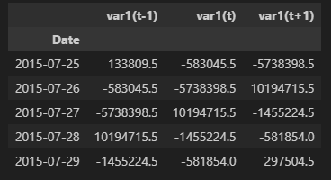
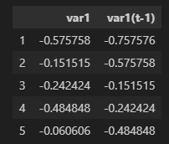
Transform the time series data into supervised learning data by creating a new y(target) column
The data is now structured for supervised learning, where var1(t-1) represents the sales difference at the previous day, var1(t) is the current day's sales difference (our target variable), and var1(t+1) is the next day's sales difference.
Scale your data in the (-1, 1) range
We'll use MinMaxScaler from Scikit-learn
to scale the data between -1 and 1
The data has been scaled to the range (-1, 1),
and we now have a dataframe scaled_data_df ready
for deep learning modeling.

Slide 34
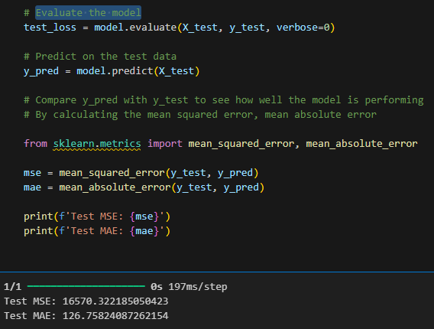
Evaluate the model
Both MSE and MAE provide a snapshot of the model's error magnitude, with MSE giving more weight to larger errors. Considering the scale of our data, the values indicate that the model is performing fairly well

Slide 35
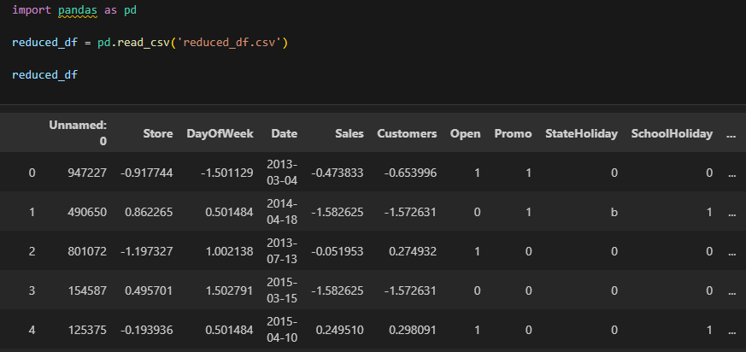
Serving predictions on a web interface
First, Now we will buid the model with reduced_df for web app creation

Slide 36
build the model with reduced_df for web app use
Again now Let's start by defining our features and target, and then splitting the data into training and testing sets

Slide 37
create a pipeline that includes the Random Forest Regressor
We'll train the model using the training data and then evaluate its performance on the test set.
Serialize the model

Slide 38
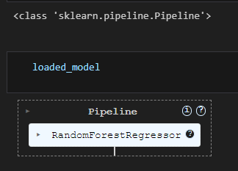
Load the model

Slide 39
Overview
A trained Random Forest model is used for making predictions.
Project overview: The project involves a Flask web application and three Jupyter notebooks tasks files focusing on data analysis and prediction modeling.
Model overview: A trained Random Forest model is used for making predictions
Data overview: The data consists of sales records from multiple stores, including dates, sales figures, and additional store-related features

Slide 40
Conclusions
The project successfully provides accurate sales forecasts that can help in strategic planning.

